Slide 1
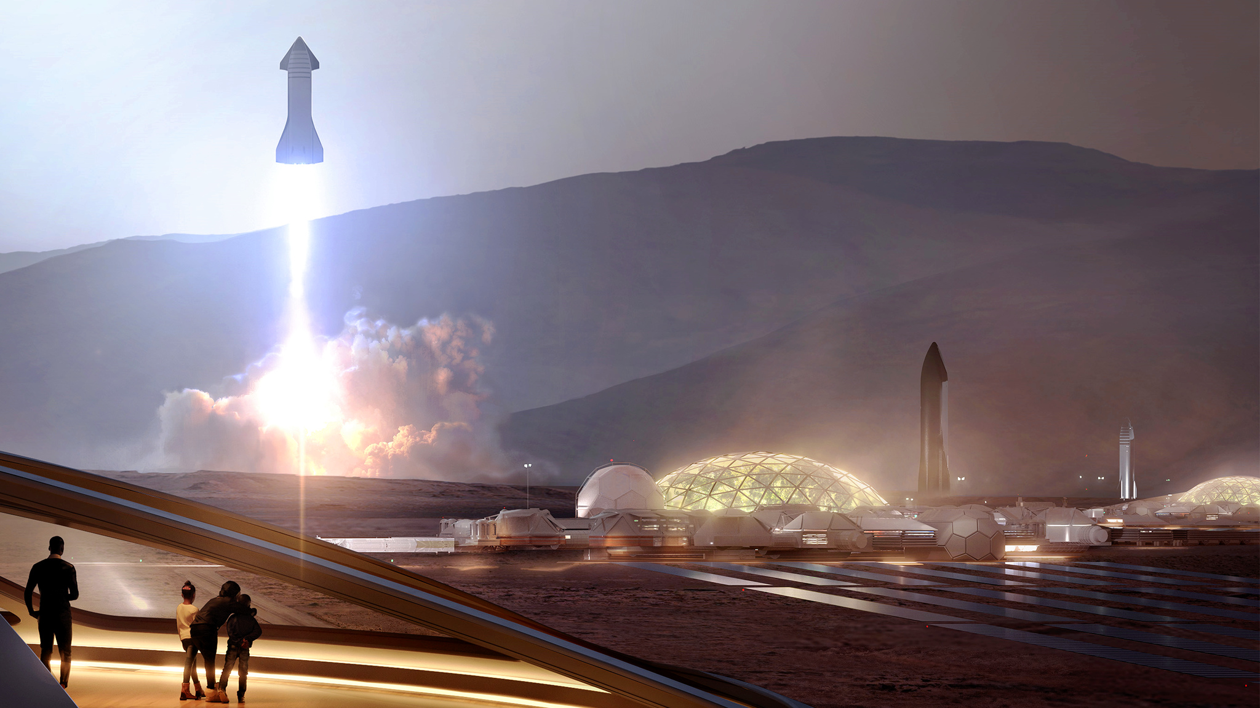


Winning Space Race
Data Science
Herman Pardo
4/20/23

Slide 2
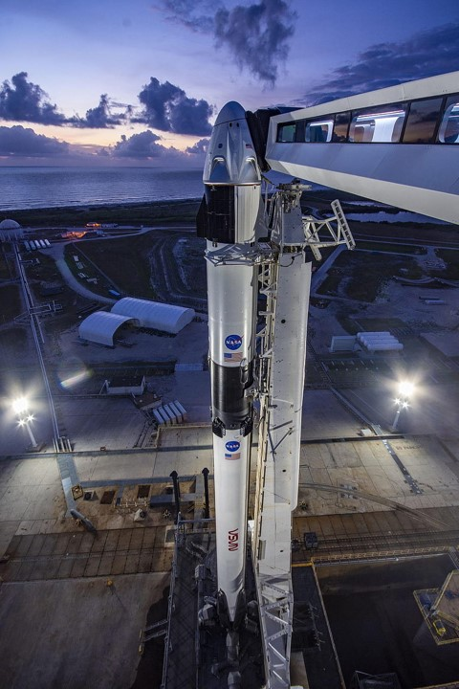

Table Of Contents
Executive Summary 3
Introduction 4
Methodology 5
Insights from EDA:
EDA with Visualization 16
EDA with SQL 23
Launch Sites Proximities Analysis – Folium 33
Plotly Dash 37
Predictive Analytics 41
Conclusion 44
Recommendation 45

Slide 3
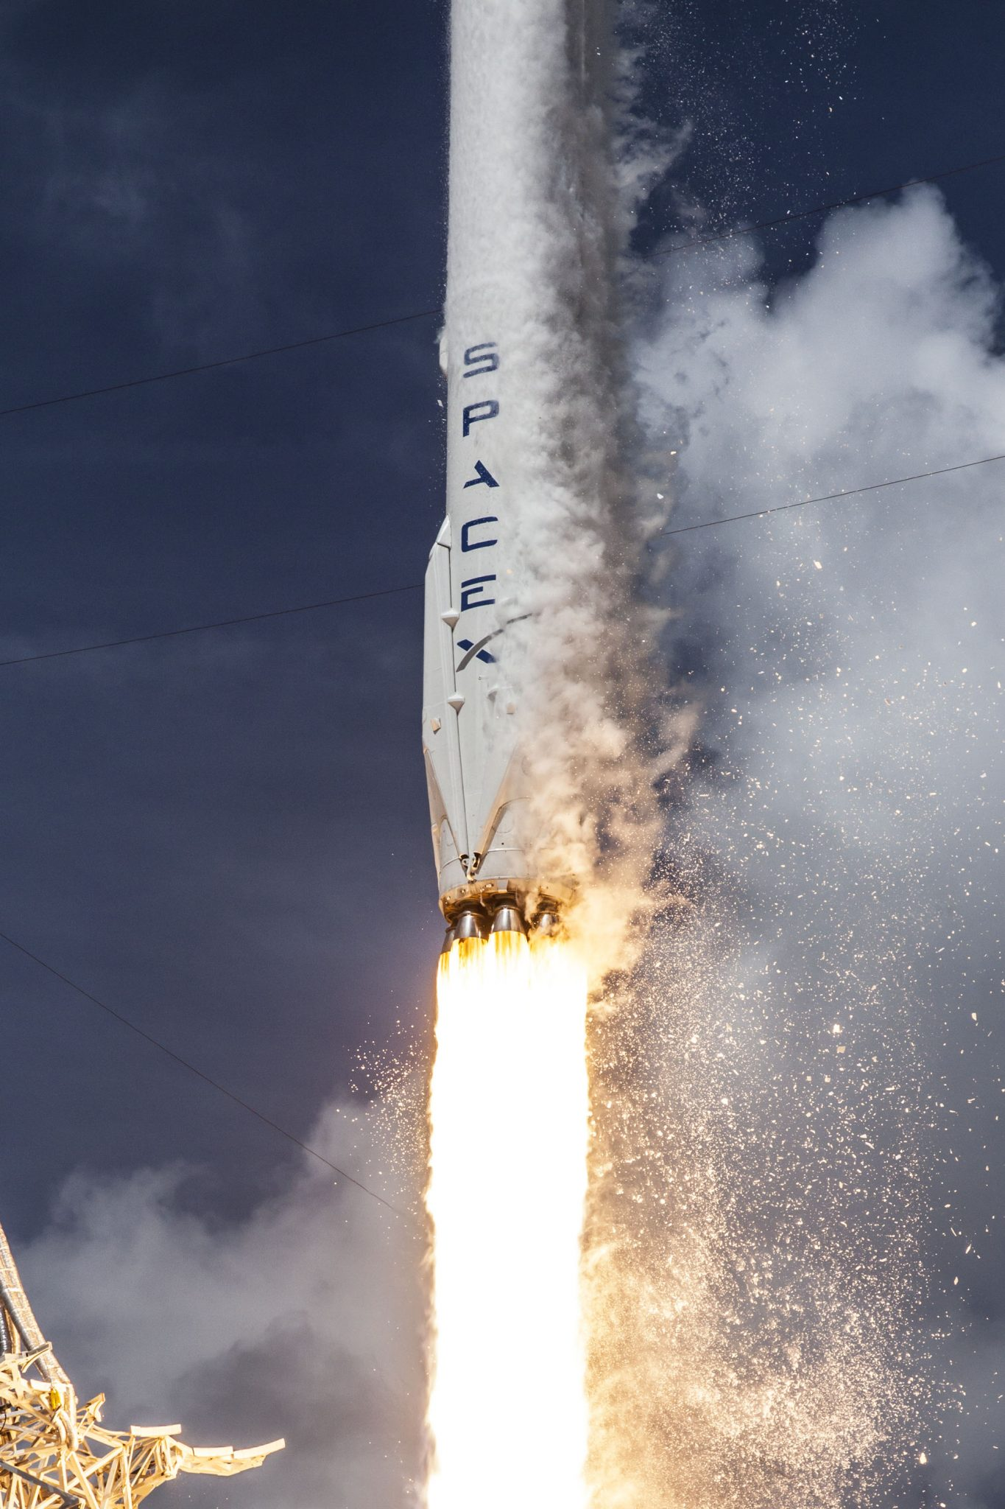
Executive Summary
Summary of Methodologies:
The objective of the research was to identify the factors that contribute to a successful rocket landing. The following methodologies were employed for this purpose:
Data Collection
SpaceX API and Web Scraping
Data Wrangling
Exploratory Data Analysis (EDA) with SQL & Data visualization
Interactive Map with Folium
Dashboard with Plotly Dash
Machine Learning Prediction
Summary of Results:
EDA
Improvement in launch success over time
KSC LC-39A having the highest success rate among landing sites
Orbits GEO, HEO, ES-L1, and SSO having the best success rate
Visualization and analytics
All launch sites are on a coast and most launch sites are located near the equator. Core factors to consider for future lunch sites.
Predictive Analytics
The Tree Classifier Algorithm is the best method for machine learning for this dataset.

Slide 4
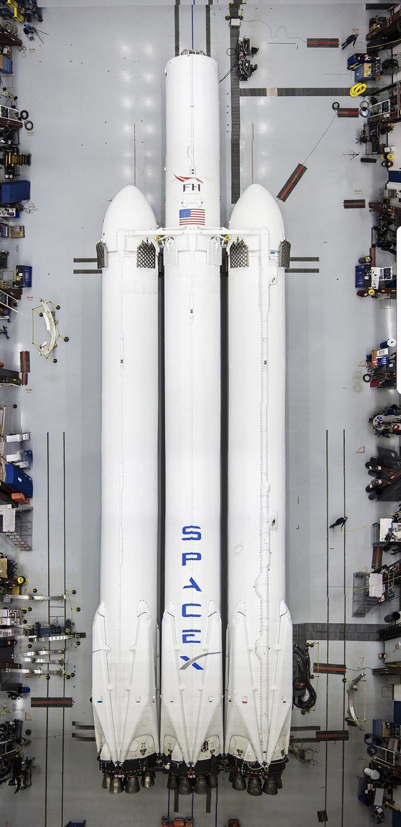
Introduction
Background
SpaceX is a pioneer in the space industry and has set its sights on making space travel accessible and affordable to the masses. Their triumphs consist of sending spacecraft to the International Space Station, launching a massive satellite constellation that provides internet access to even the most remote locations on Earth, and sending astronauts on manned missions to space.
One of the main reasons SpaceX has been so successful is due to significantly being able reduce the cost of rocket launches. The innovative reusing of the first stage of the Falcon 9 rocket has dramatically reduced the cost of each launch to just $62 million compared to other providers that costs upwards of $165 million per launch.
The key to determining the price of a launch is whether the first stage will land. Using public data and machine learning models, it is possible to predict whether SpaceX will be able to reuse the first stage. This data-driven approach helps to make space travel more affordable and accessible to everyone, enabling more people to explore the cosmos and achieve their dreams of space exploration.
Discover
The relationship between launch site, mass, number of flights, and orbit types affect the success of landing for the first stage rocke
The landing success rate over the lifetime of the company
conditions does SpaceX have to achieve to get the best results and ensure the best rocket success landing rate.

Slide 5
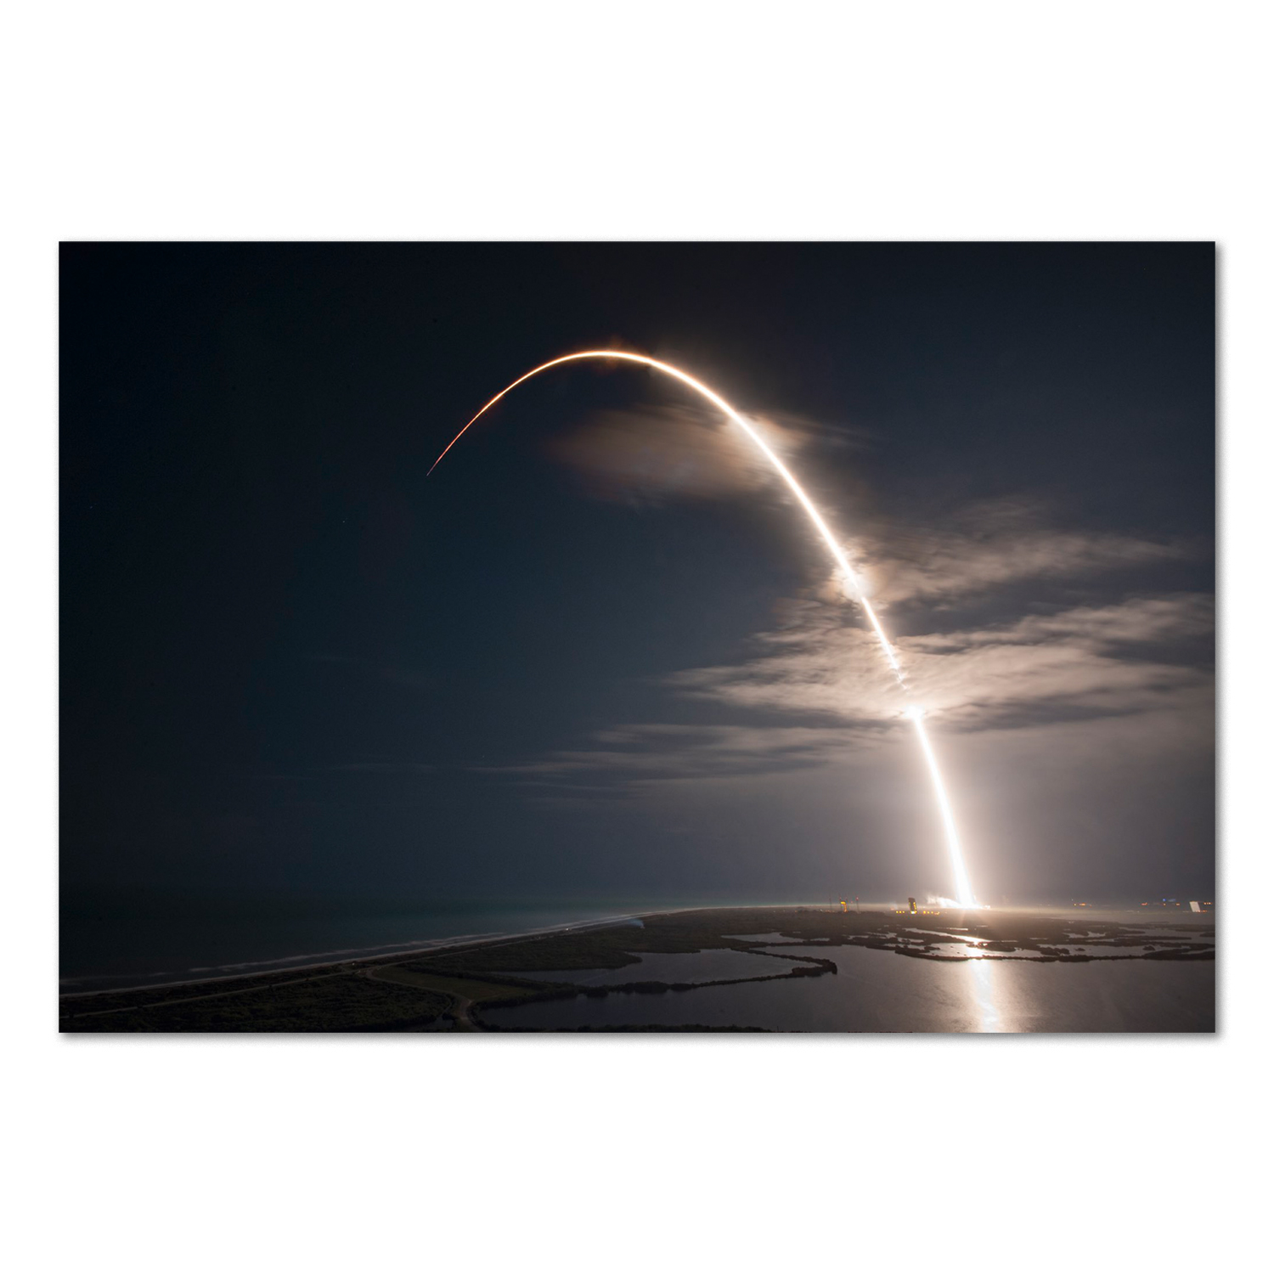
Section 1
Methodology

Slide 6
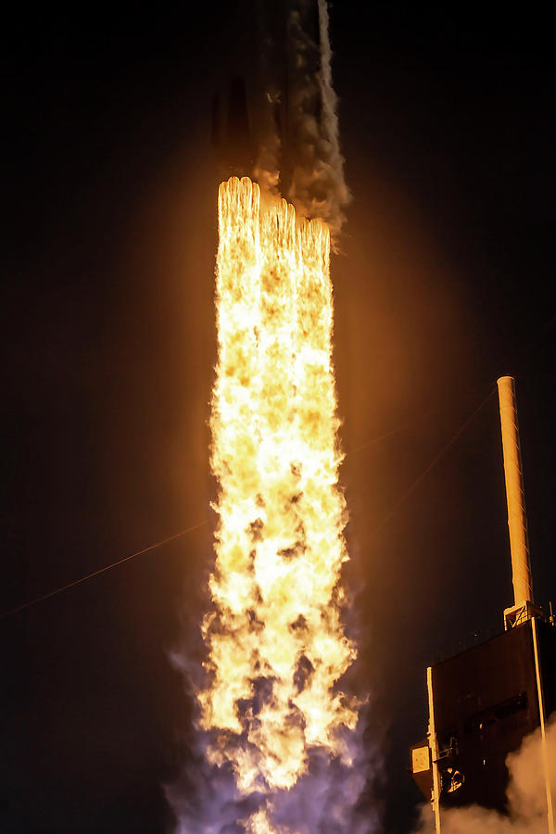
Methodology
Collect
SpaceX REST API
Web Scraping Techniques
Wrangle
Clean data for handling
One Hot Encoding: prepare data for machine learning modeling
Explore
Exploratory Data Analysis (EDA) with SQL and data visualization
Visualize
Variable relationships through scatter, bar, and line graphs
Machine Learning
Folium
Plotly Dash
Predict landing outcomes through machine learning
Build, tune, and evaluate classification models

Slide 7
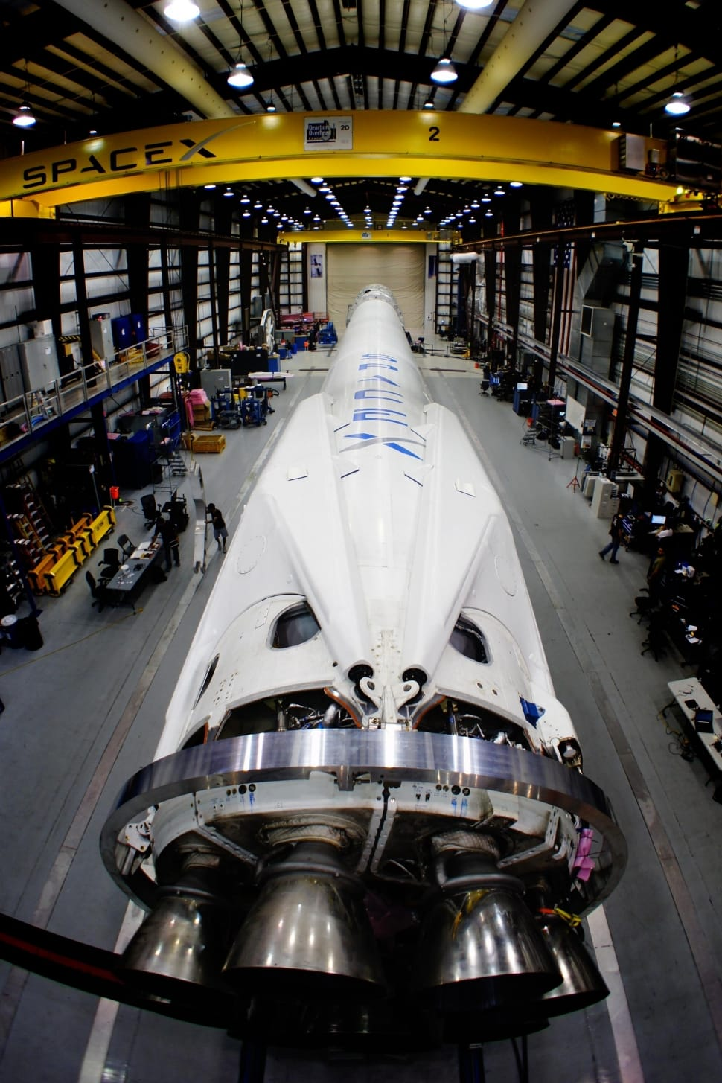

Data Collection – SpaceX API
Request SpaceX data with REST API
API fetches SpaceX rocket launch data in .json format
Use custom functions to get data lists needed
Assign list to dictionary
Assign dictionary to dataframe
Filter dataframe for Falcon 9 launches only
Replace missing values
Export data to .csv file
GitHub
Notebook URL

Slide 8
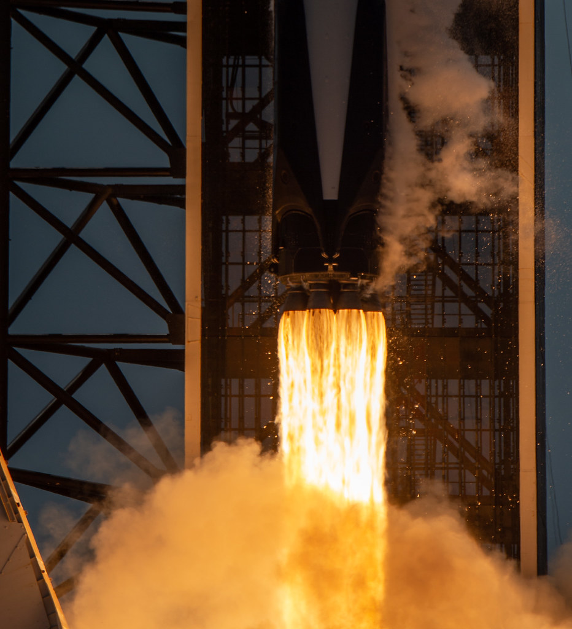
Data Collection – Web Scrapping
Request SpaceX launch data from Wikipedia
Create BeautifulSoup object from HTML response
Extract column names from table header
Collect data from parsing tables
Create dictionary from the data
Create dataframe from dictionary
Export dataframe to csv file
Find tables in the site
GitHub
Notebook URL

Slide 9

Data Wrangling
Process:
Perform exploratory data analysis and determined the training labels.
Calculate:
Number of launches at each site
number and occurrence of each orbits and outcome
Create landing outcome label from outcome column and exported the results to a csv file
Convert outcomes into binary:
1 for successful landing
0 for unsuccessful landing
Common orbit types for rocket launches:
Landing Outcomes | Description
True Ocean | Mission outcome had a successful landing to a specific region of the ocean
False Ocean | Unsuccessful landing to a specific region of ocean
True RTLS | Successful landing on a ground pad
False RTLS | Unsuccessful landing on a ground pad
True ASDS | Successful landing on a drone ship
False ASDS | Unsuccessful landing on drone ship
GitHub
Notebook URL

Slide 10

EDA – Visualization
Scatter Graphs
Visualize the correlation between two variables and how much one variable is affected by another. These variables may aid machine learning. The following scatter graphs will be presented:
Flight Number VS. Payload Mass
Flight Number VS. Launch Site
Payload VS. Launch Site
Orbit VS. Flight Number
Payload VS. Orbit Type
Orbit VS. Payload Mass
Bar Graph
Easy way to observe the comparison between different groups of data. The following bar graph will be presented:
Mean vs. Orbit
Line Graph
Method that connects a series of data points to show trends and data variables that help make predictions. The following line graph will be presented:
Success Rate vs Year
GitHub
Notebook URL

Slide 11
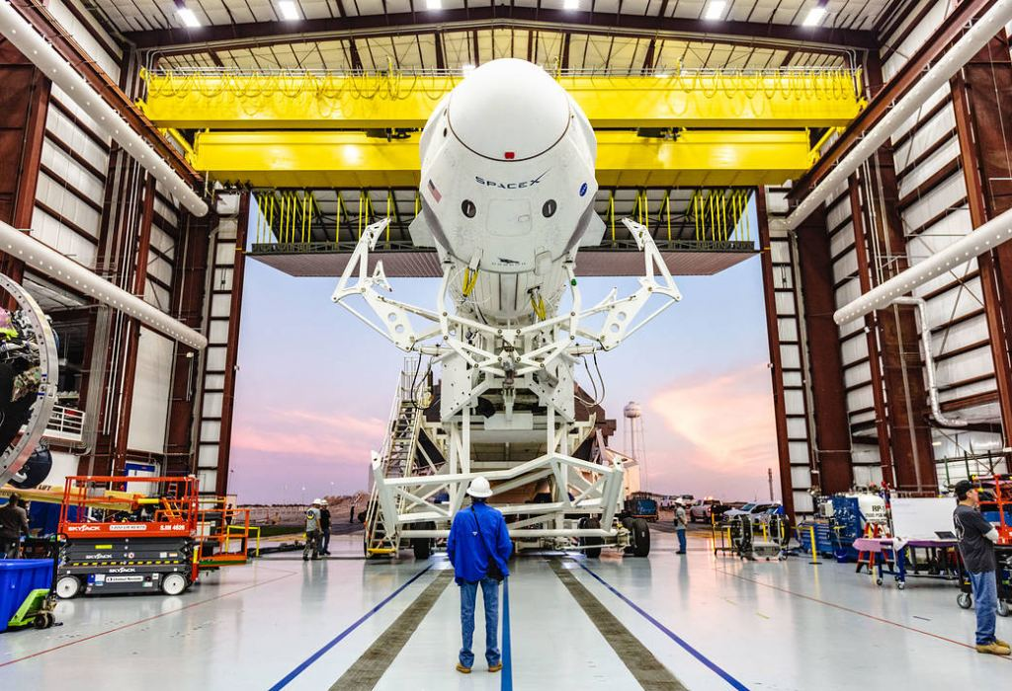
EDA – SQL
10 SQL queries were executed to display and list results as follows:
Display
Names of unique launch sites
5 records where launch site begins with ‘CCA’
Total payload mass carried by boosters launched by NASA (CRS)
Average payload mass carried by booster version F9 v1.1.
List
Date of first successful landing on ground pad
Names of boosters which had success landing on drone ship and have a payload mass greater than 4,000 but less than 6,000
Total number of successful and failed missions
Names of booster versions which have carried the max payload
Failed landing outcomes on drone ship, their booster version and launch site for the months in the year 2015
Count of landing outcomes between 2010-06-04 and 2017-03-20 (desc)
GitHub
Notebook URL

Slide 12

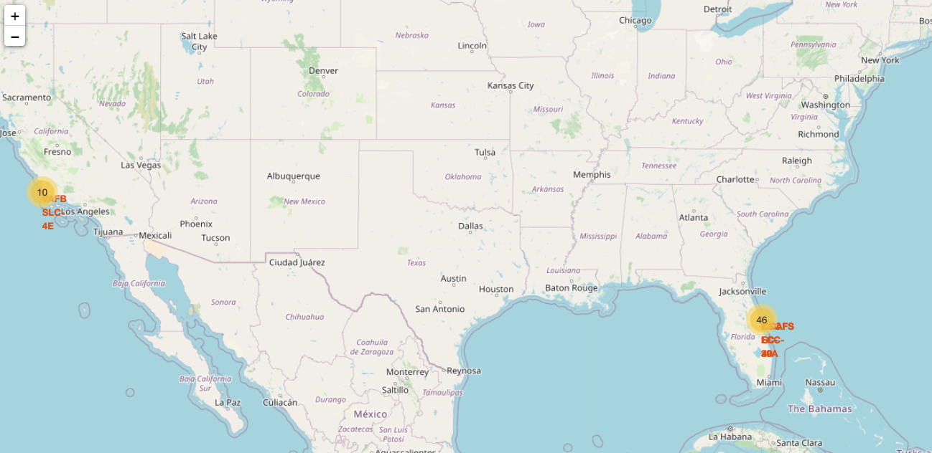

Map – Folium
Using Folium in Python, the following objects were placed on a map to illustrate the extracted launch data with insight:
Red circle markers are placed around each launch site using the GPS coordinates. Also added labels to each site to better identify locations.
Green and Red markers are used at the launch site to represent the successful and failed launch outcomes
Lines are used on the map to measure distance from CCAFS SLC-40 launch site to landmarks using Haversine’s formula. These lines show the nearest city, highway, railway, and coastline in order to easily visualize the surrounding environment. Such data can be used to create requirements for building a rocket launch facility from a safety point of view.
GitHub
Notebook URL

Slide 13
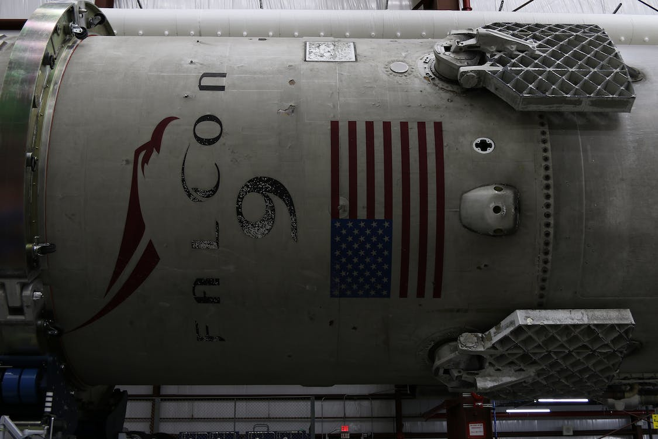
Dashboard – Plotly
Interactive dashboard was built using Plotly:
Dropdown menu with launch sites available to be selected
Pie charts show the total launches by a certain sites
Interactive slider object allows the selection of payload mass change
Scatter graph shows the success rate relationship between Outcome and
Payload Mass by booster version
GitHub
Notebook URL

Slide 14
Predictive Analytics (Classification)
Data Load
Standardize
Clean, transform, and fit data
Split
Use train_test_split to create training and testing data
Create ML Models
Use pandas and numpy to load and create array
Use GridSearchCV on different models: Logistic Regression, Support Vector Machine, Decision Tree Classifier, K-Nearest Neighbor
Accuracy Test
Use .score() on all models to calculate accuracy
Confusion Matrix
Evaluate confusion matrix on all models
Find Best Model
Use Jaccard_Score, F1_Score, and accuracy to find the best model
GitHub
Notebook URL

Slide 15
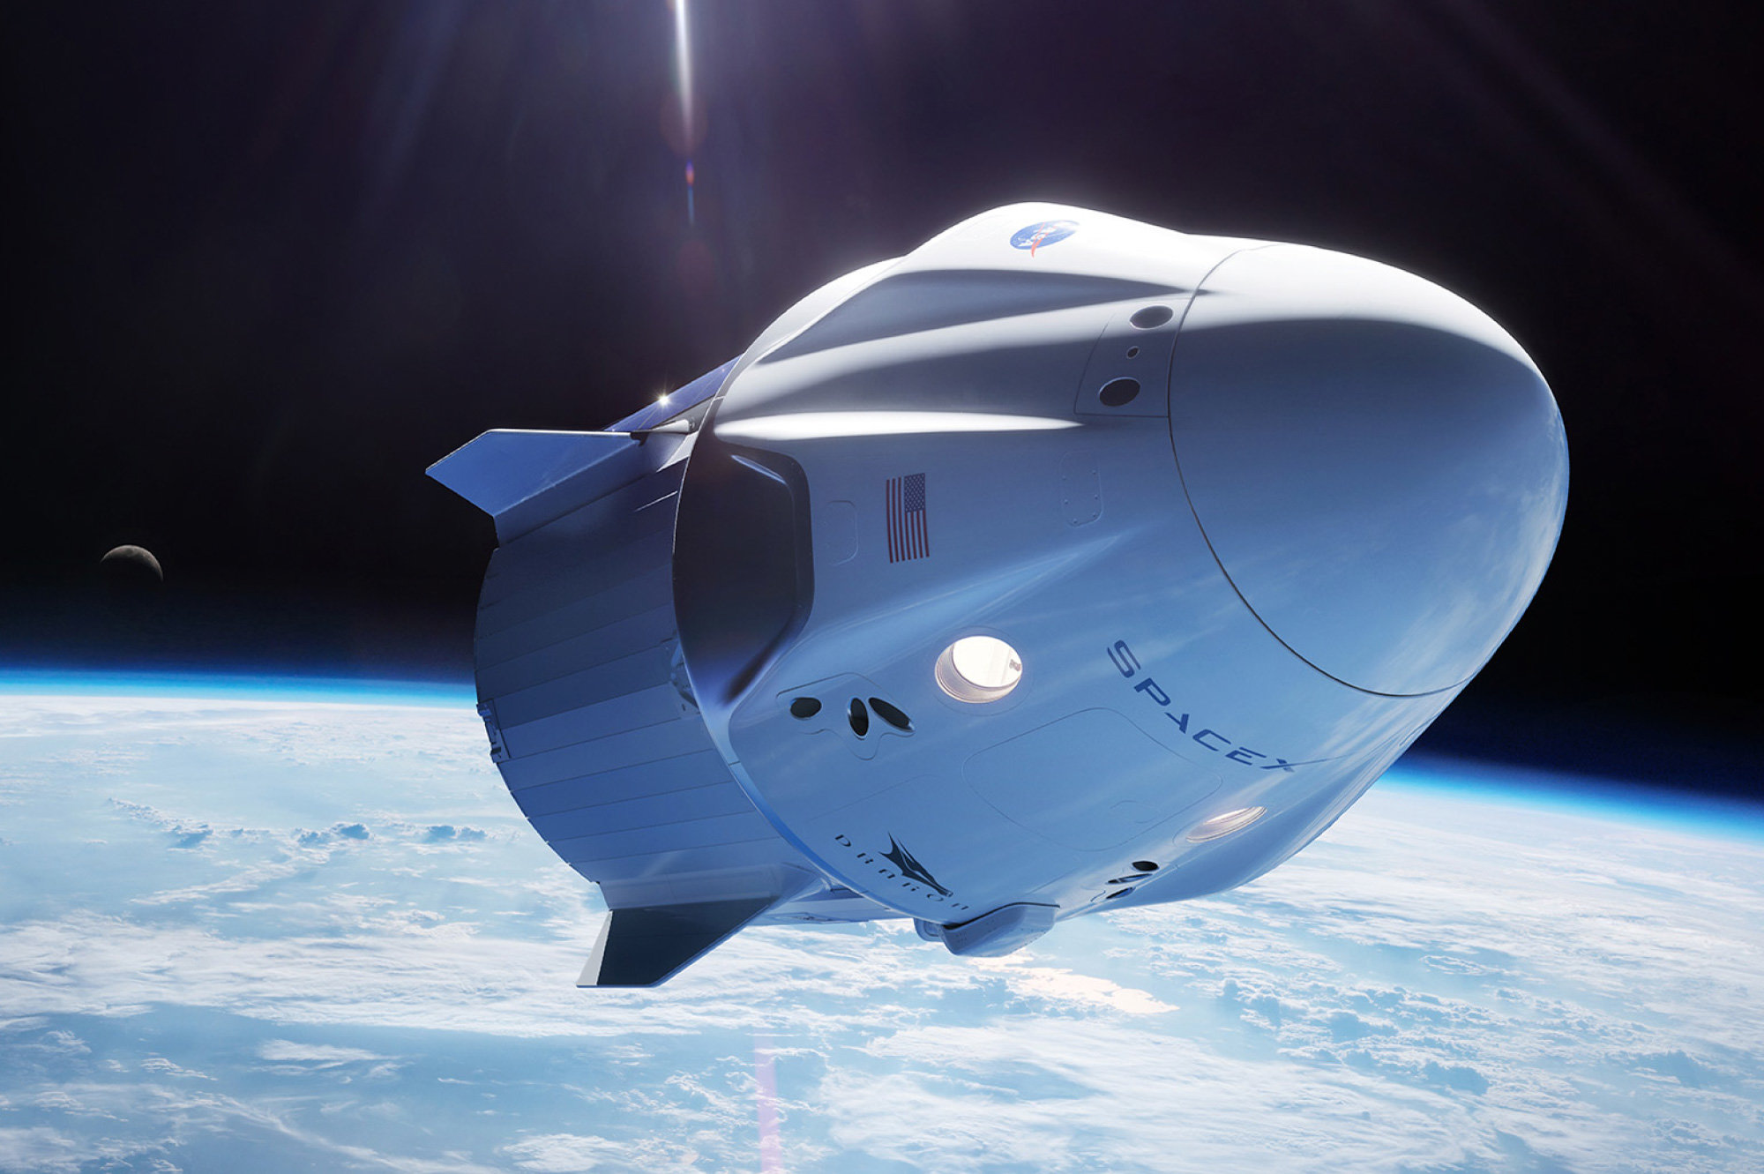
Results Summary
Exploratory Data Analysis
Falcon 9 rocket launch success has improved over time
KSC LC-39A has the highest success rate of all sites
Orbits ES-L1, GEO, HEO, and SSO all have a 100% success rate
Interactive Analytics
Visual mapping reveals that all launch sites are close to a coast as well as most near the equator.
Due to the explosive nature of rocket launches, launch sites are positioned just far enough away to not disrupt civilian structures
Predictive Analysis
Evaluation of ML models shows Decision Tree model to be the best predictive model for this data

Slide 16
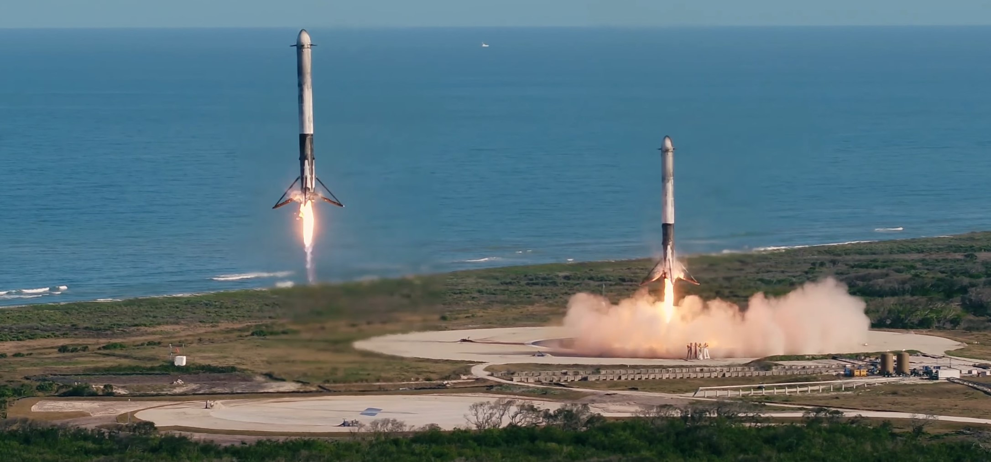
Section 2
Insights
from eda

Slide 17
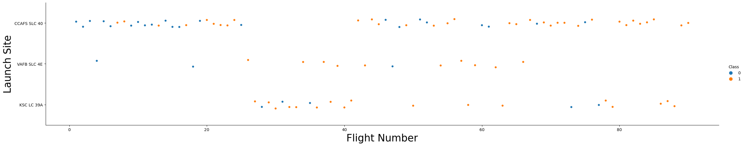
Flight Number vs. Launch Site
Earlier flights ( • ) had a lower success rate compared to the later flights ( • )
Launches improved in success rate over time
Launch site CCAFS SLC-40 has almost 2x amount of the other two combined
CCAFS SLC-40 has the least success rate of all the launch sites

Slide 18
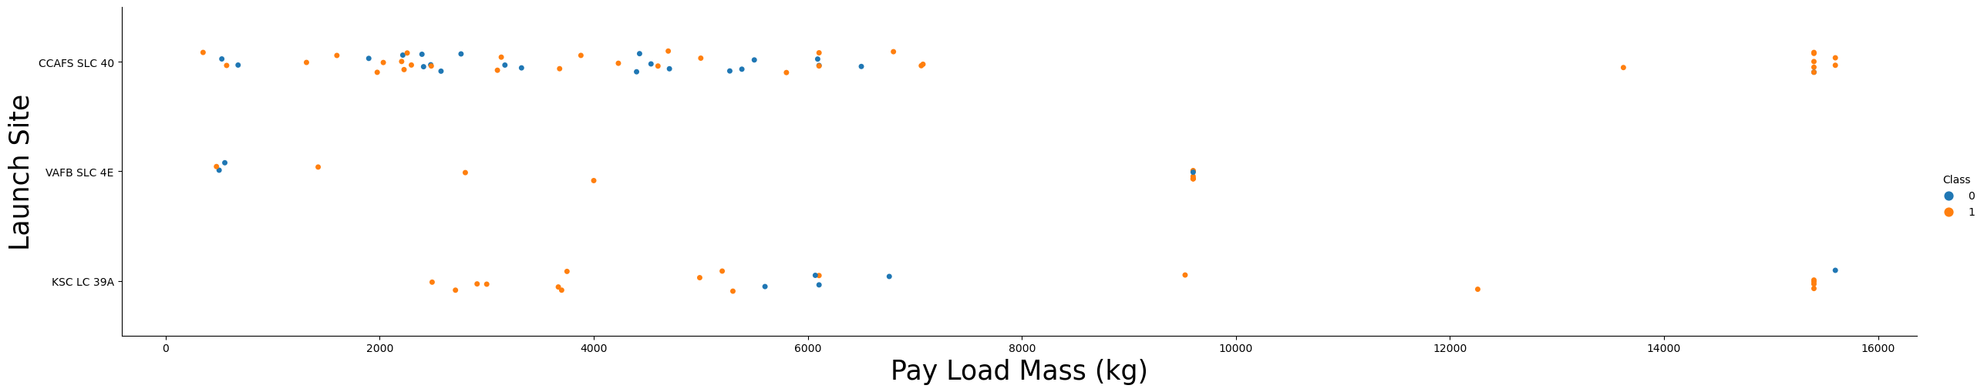
Payload vs. Launch Site
KSC LC 39A has a launch success rate of 100% for payloads less than 5,500kg
Higher payloads have greater chance of success rate
VAFB SLC 4E doesn’t launch anything over 10,000kg
CCAFS SLC-40 has the least success rate of all the launch sites

Slide 19
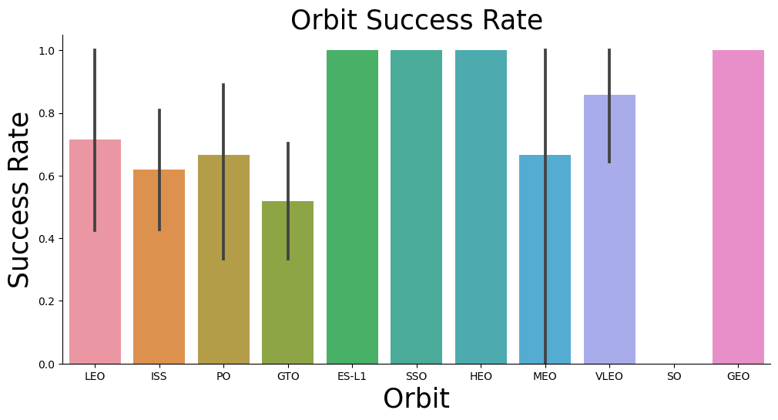
Success Rate vs. Orbit Type
Success Rate:
100%: ES-L1, SSO, HEO, GEO
90% - 70%: LEO, VLEO
70% - 50%: ISS, PO, GTO, MEO
0%: SO

Slide 20
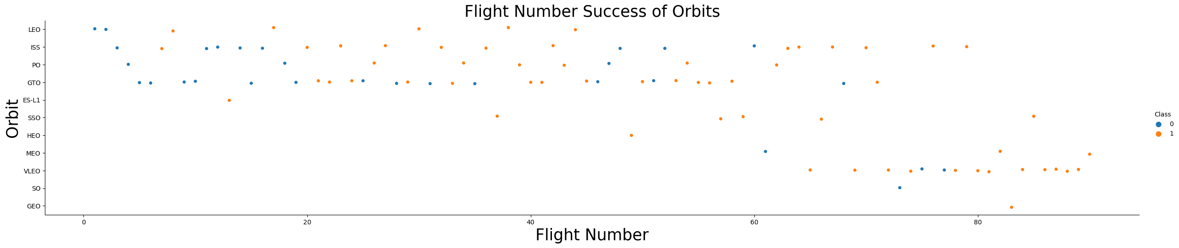
Flight Number vs. Orbit
Success rate improves with number of launches at all sites
SO has 100% failure due to only having 1 launch
GTO is the slowest rate of improvement
Second half of all flights show significant improvement over first half of all flights

Slide 21
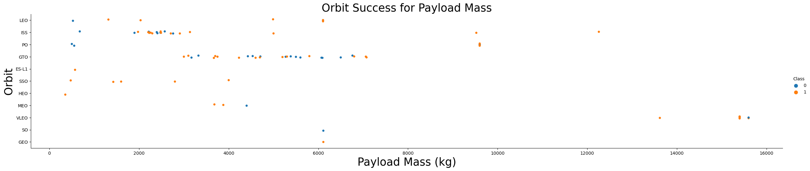
Payload vs. Orbit Type
GTO success rate lowers with heavier payloads
SSO, MEO, HEO have 100% success rate with payload less than 4,000kg

Slide 22
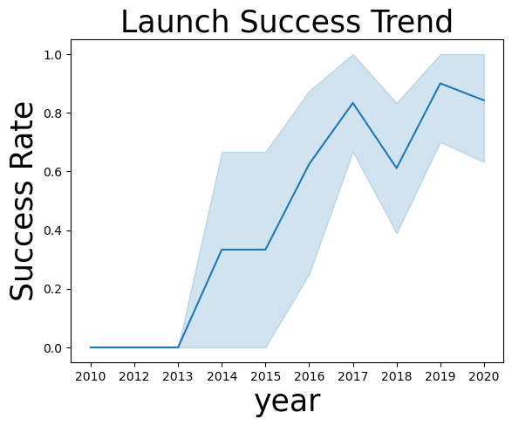
Launch Success Yearly Trend
EDA:
Overall rate of success has improved since 2013
2017 & 2019 should be examined to improve common points of failures
Failure rate decreases over time on failed years.

Slide 23
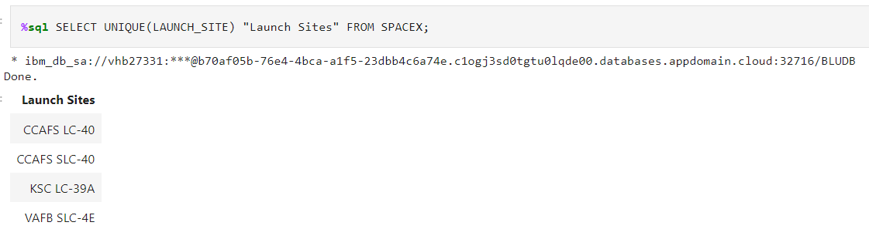
All Launch Site Names
Using SQL in python, all the site names were able to be retrieved:
There are 4 total launch sites
2 at Cape Canaveral Air Force Station
1 at Kennedy Space Center
1 at Vandenberg Air Force Base

Slide 24
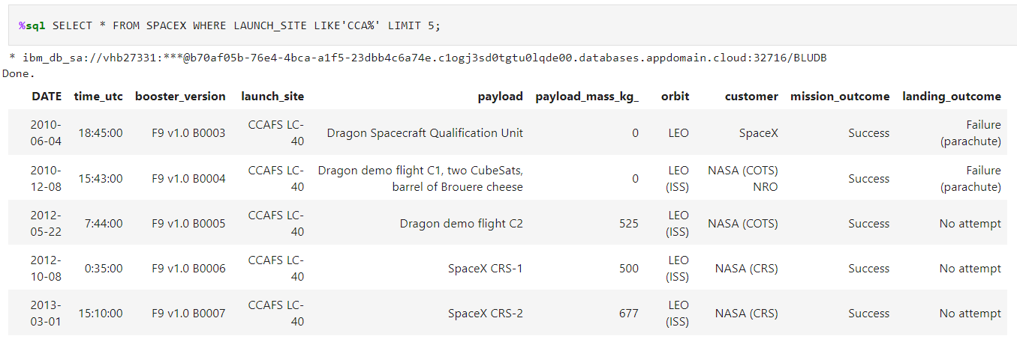
Launch Site Names Beginning With ‘CCA’
Using SQL in python, we found 5 site names beginning with ‘CCA’:
Narrow down the list of launches to only those beginning with ‘CCA’ for Cape Canaveral Air Force Station

Slide 25
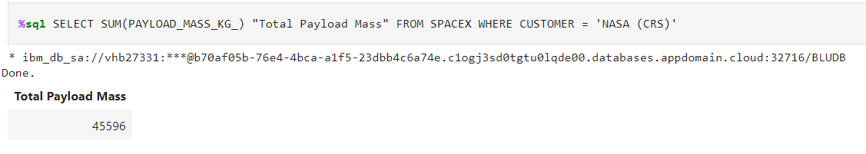
Total Payload Mass
Using SQL in python, we calculated the total payload carried by boosters from NASA:
NASA’s total payload mass from launches is 45,596 kg

Slide 26
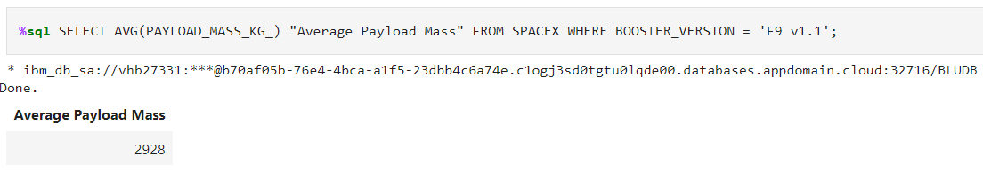
Average Payload Mass by F9 v1.1
Using SQL in python, we calculated the Average Payload Mass by F9 v1.1:
The average payload from booster version 1.1 of a Falcon 9 rocket is 2,928 kg

Slide 27
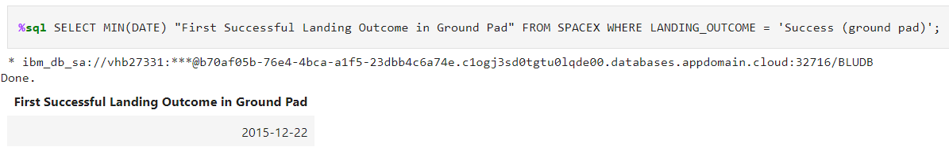
First Successful Ground Landing Date
Using SQL in python, we calculated the First Successful Ground Landing Date:
On December 22, 2015, SpaceX had it’s first successful landing on ground pad

Slide 28
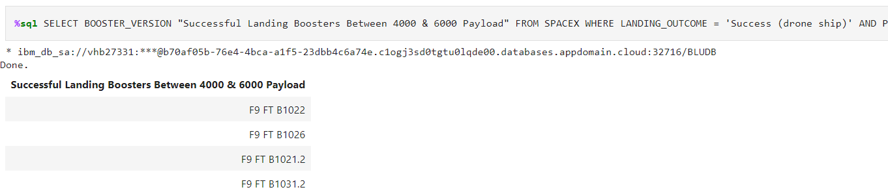
Successful Drone Ship Landing with Payload
Between 4,000 kg & 6,000 Kg
Using SQL in python, we found the names of boosters which have successfully landed on drone ship and had payload mass greater than 4,000 kg but less than 6,000 kg:
There are 4 booster versions that have been able to land successfully on a drone ship after launching with a payload between 4,000 kg and 6,000 kg

Slide 29
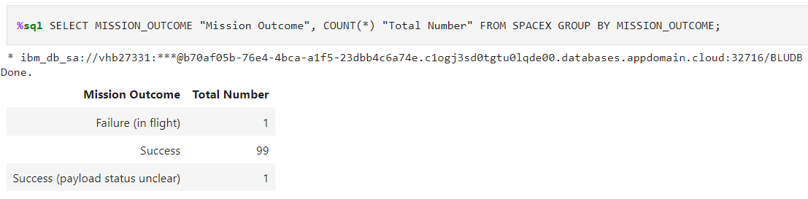
Total Number of Successful and Failure Mission Outcomes
Using SQL in python, we calculated the total number of successful and failure mission outcomes:
There have been a total of 100 successful missions (1 where payload status is unclear) and 1 Failure

Slide 30
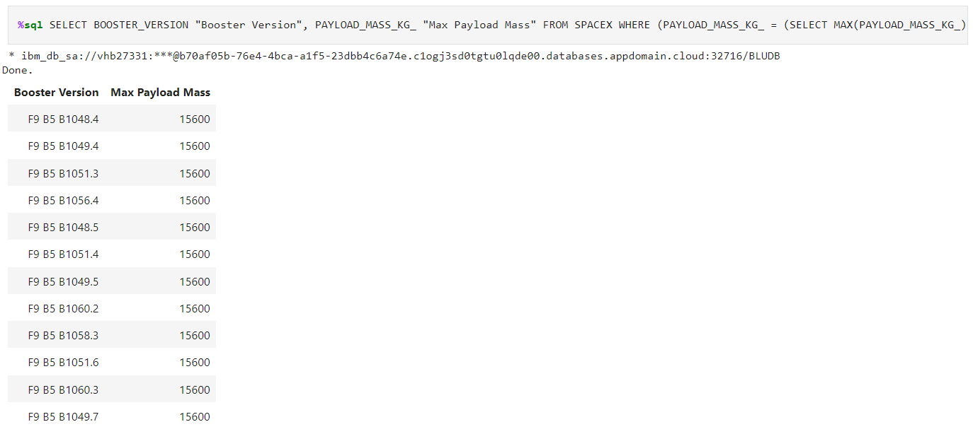
Boosters Carried Maximum Payload
Using SQL in python, we found the names of the booster which have carried the maximum payload mass:
There are 12 boosters that have carried the max payload of 15,600 kg

Slide 31
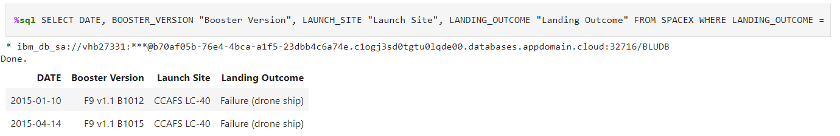
2015 Launch Records
Using SQL in python, we found the failed landing outcomes on drone ship, their booster versions, and launch site names for in year 2015:
There are 2 failed landing outcomes on a drone ship in 2015. Both are from the same launch site in almost exactly 3 months apart.

Slide 32
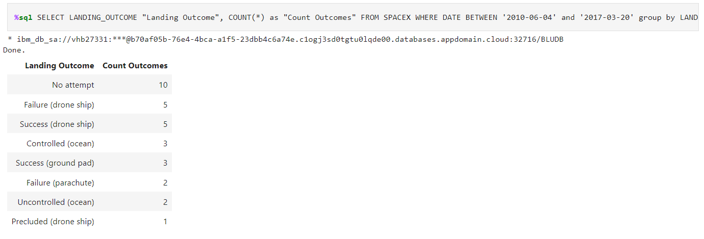
Rank Landing Outcomes Between 2010-06-04 & 2017-03-20
Using SQL in python, we ranked the count of landing outcomes (such as Failure (drone ship) or Success (ground pad)) between the date 2010-06-04 and 2017-03-20, in descending order:
Of the 31 launches, there are only 8 fully successful missions, a 25.8% success rate.

Slide 33
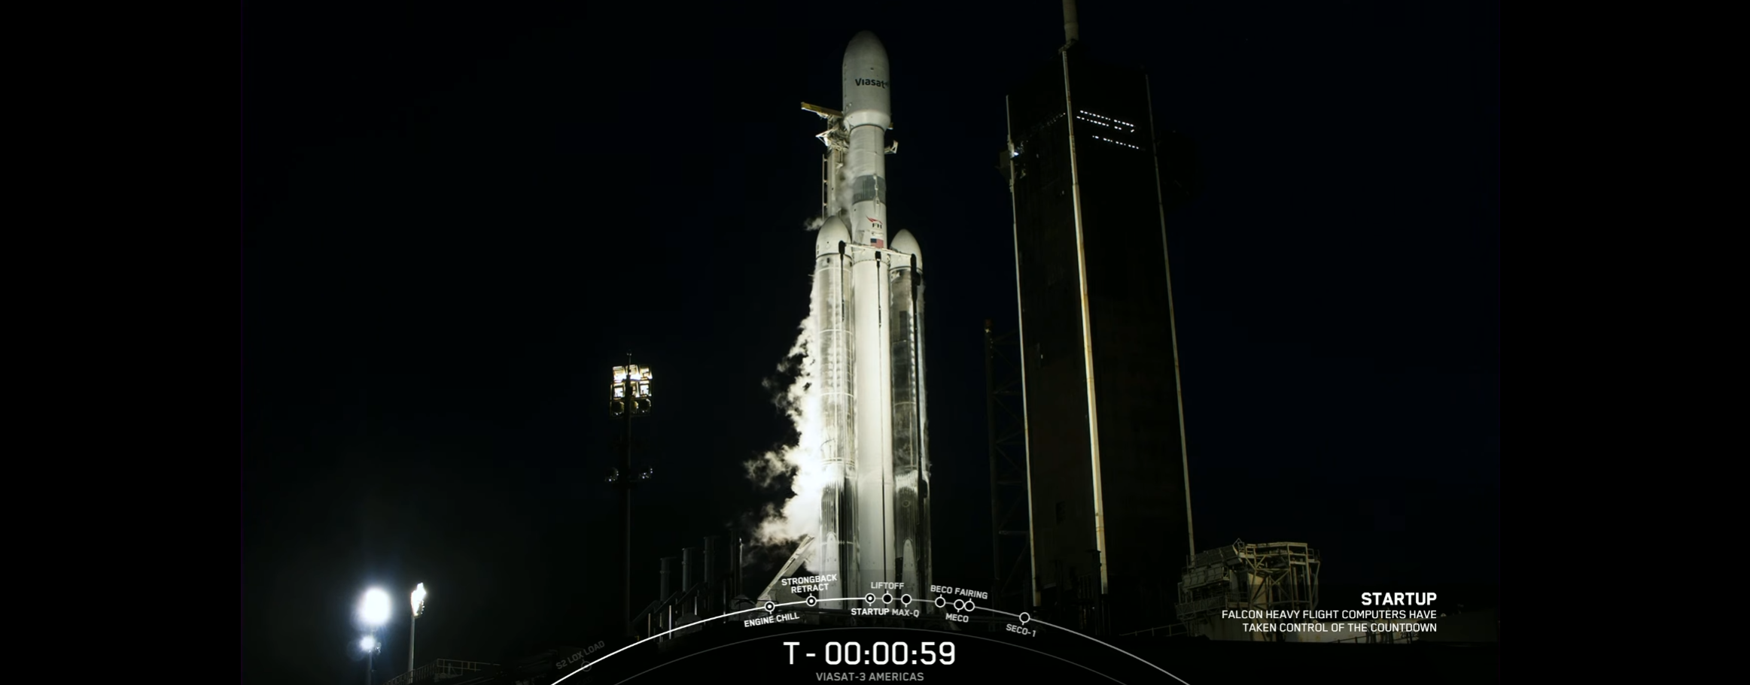
Section 3
Launch Sites
Proximities
Analysis

Slide 34
Global Launch Site Map
Using Folium in Python, a global map of earth is abled to be rendered with the locations of all launch sites.
Common trait between them all is that they are built near coastal waters.

Slide 35
Site Launch Outcome Results Map
Using Folium in Python, each launch site is outlined by a red circle that when selected, it displays the launch outcomes in green (success) and red (fail) markers
In the example below, CCAFS SLC-40 launch site has 7 launches, with 3 succeeding and 4 failing

Slide 36
Launch Site Proximities Map
Using Folium in Python, each launch site shows its proximities to nearest railway, highway, coastline along with the calculated distance displayed
In this example, the nearest coastline to launch site CCAFS SLC-40 is the Atlantic Ocean located 0.90 KM

Slide 37
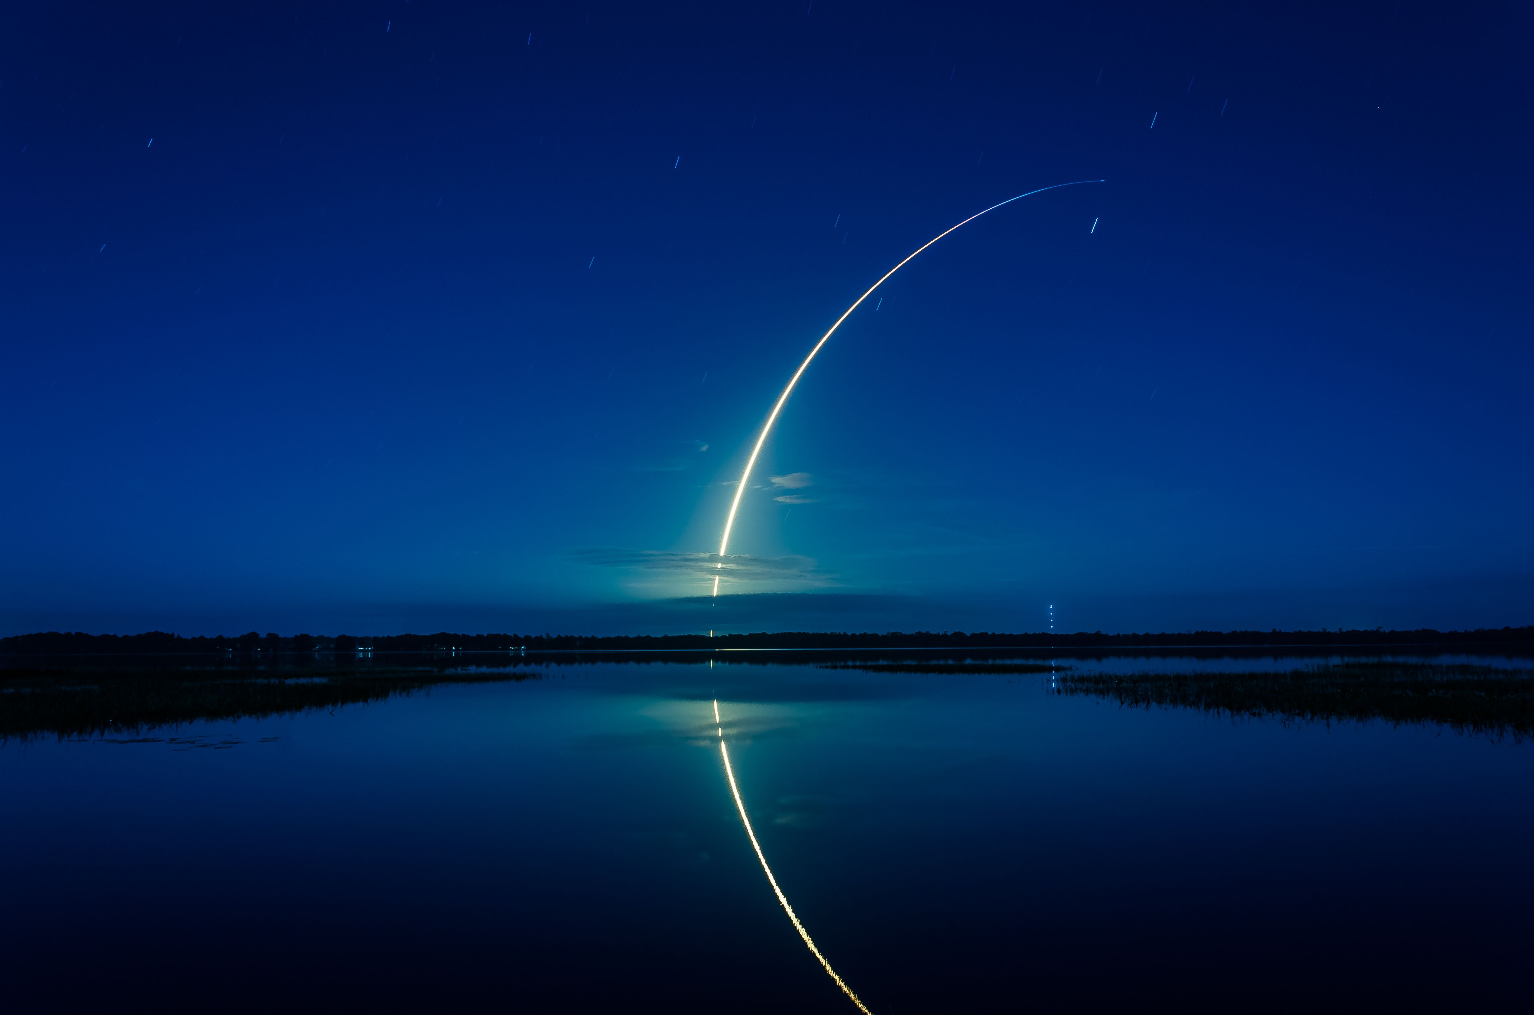
Section 4
Plotly Dashboard

Slide 38
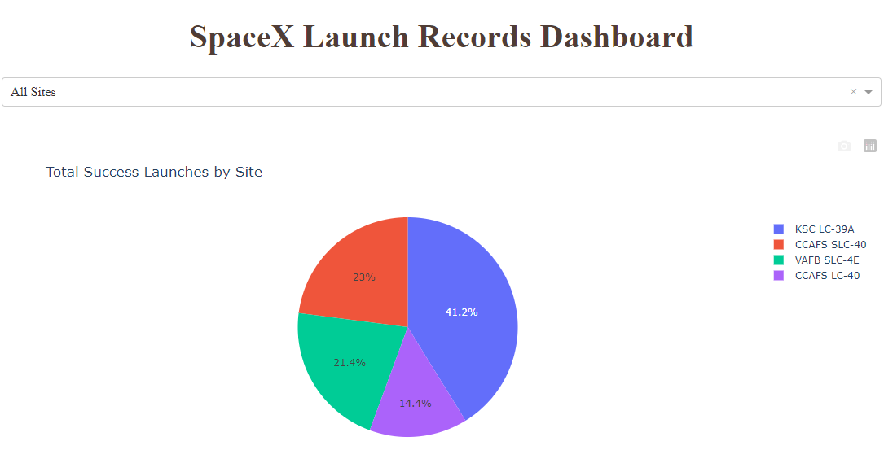
Successful Launch Count of All Sites
Above: Rates of success per launch site indicate that KSC LC-39A has the highest total success rate at 41.2%

Slide 39
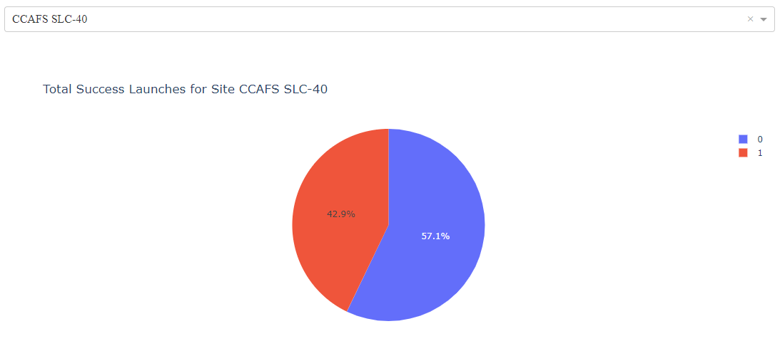
Highest Success Launch Site
Above: CCAFS SLC-40 launch site has the highest launch success ratio of all sites at 42.9%

Slide 40
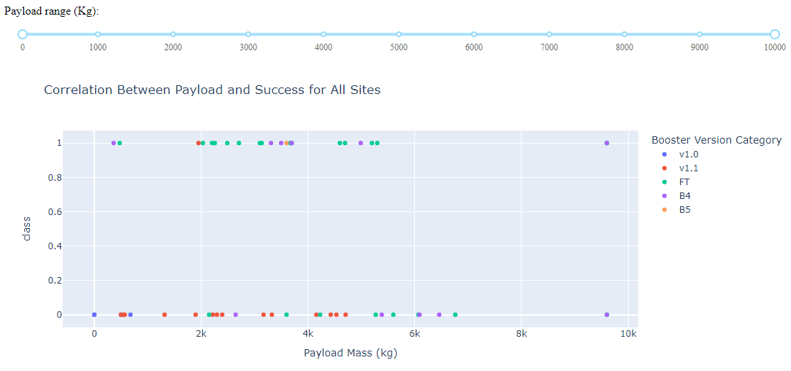
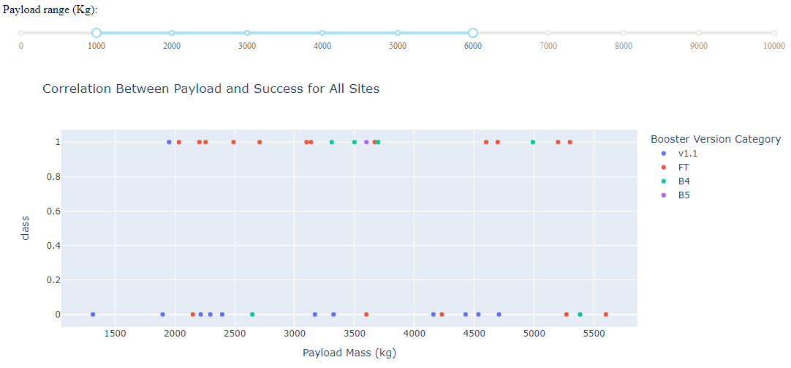
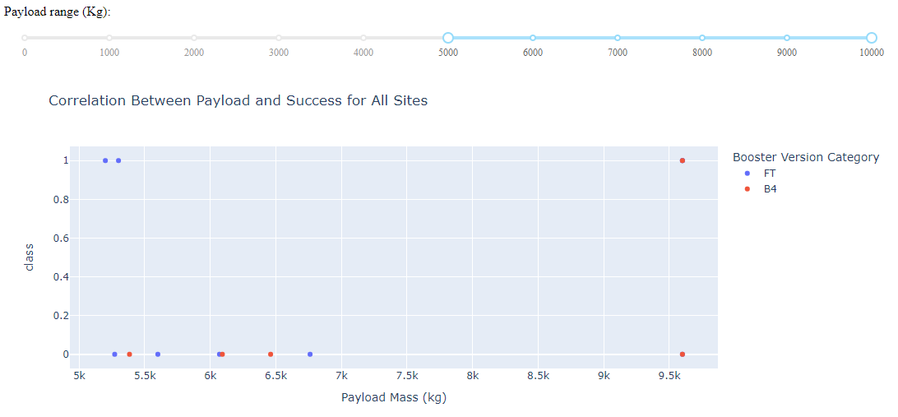
Payload vs. Launch Scatter Plot
The interactive slider allows the user to adjust the payload range to compare figures
From figure B and C it can be concluded that there’s a significant difference in higher success rate of lighter loads (B), compared to that of heavier loads (C)
Scatter plot can compare the success rate of all launches of up to a payload of 10,000 kg.
A
B
C

Slide 41
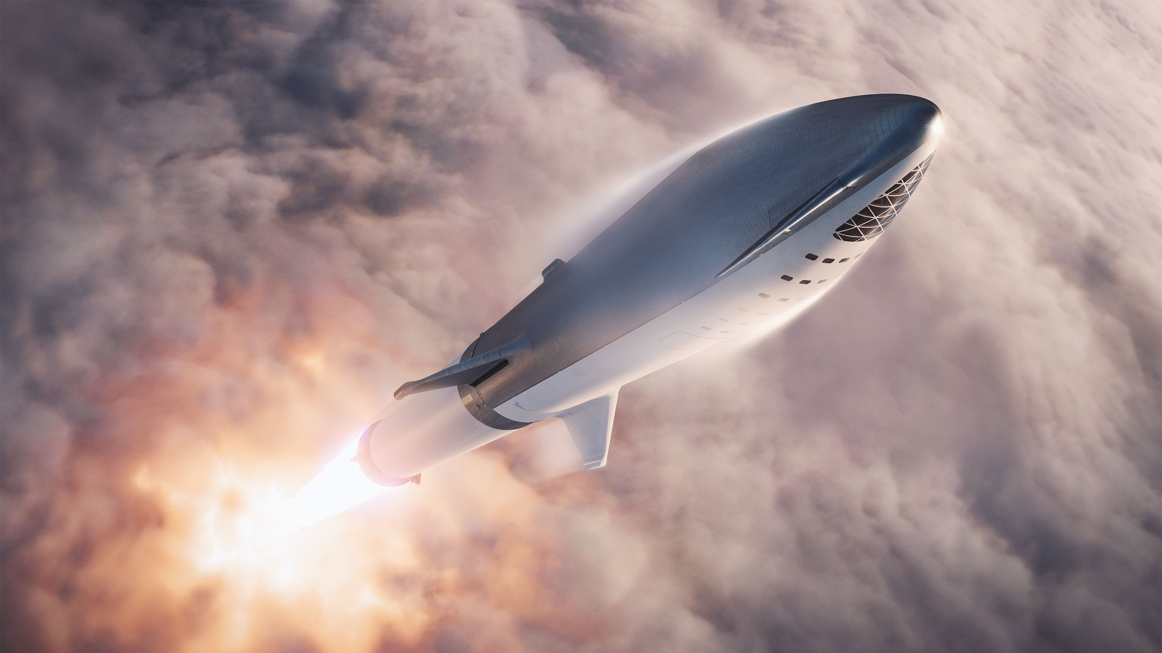
Predictive
Analytics

Slide 42
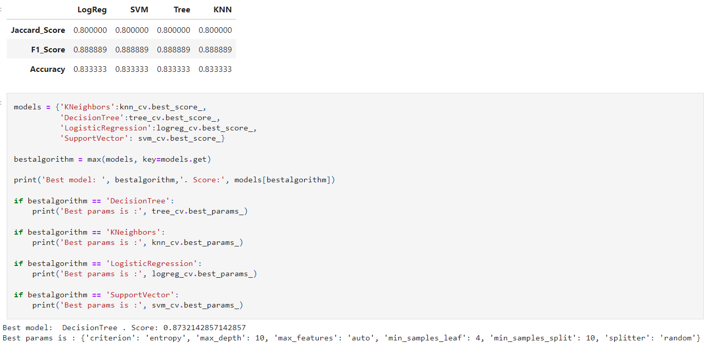
Classification Accuracy
From chart and bar graph we can see that all models are relatively close in results.
Using parameters and testing, we found the following model to be the best:
Decision Tree
Score: 0.87321
The parameters that best suited the model are as follows:
Criterion: entropy
Max_depth: 10
Max_features: auto
Min_samples_leaf: 4
Min_samples_split: 10
Splitter: random

Slide 43
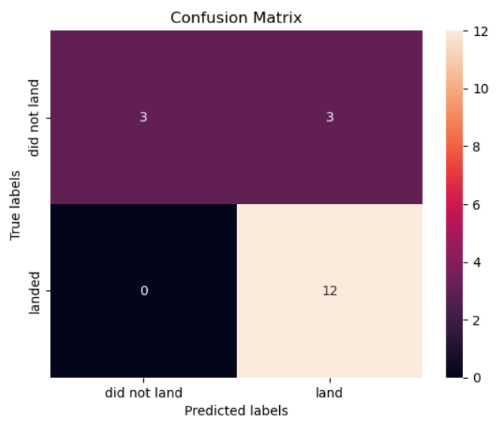
Confusion Matrix
Performance Summary:
All model confusion matrices were identical
Confusion Matrix Outputs:
12 True positive
3 True negative
3 False positive
0 False Negative
Having 3 false positives is the only Type 1 error that should be taken into consideration since those are unsuccessful landing marked as successful landing by the classifier
Precision TP / (TP + FP) | Recall TP / (TP + FN) | F1 Score 2 * (Precision * Recall) / (Precision + Recall) | Accuracy (TP + TN) / (TP + TN + FP + FN)
12 / 15 | 12 / 12 | 2 * (.8 * 1) / (.8 + 1) | (12+3)/(12+3+3+0)
.80 | 1 | .89 | .833

Slide 44
Conclusion
Summary Outlook:
Overall launch success rate is directly proportional to the time SpaceX has started as it has learned greatly from its failures and will one day perfect them
Launch bases all follow the same location scheme:
Always on coastline and away from civilian infrastructure for safety
Most near equator due to the increase in boost from rotation of the earth that help in the savings of fuel
Machine Learning model with the best performance is Decision Tree, which is recommended for the studying of these results in the future.
Having 3 false positives is the only Type 1 error that should be taken into consideration
Data Number Results:
Orbits ES-L1, GEO, HEO, SSO have a 100% success rate
CCAFS SLC-40 has the highest launch success ratio of all sites at 42.9%
KSC LC-39A has the highest total success rate at 41.2% and 100% success rate for payloads less than 5,500 kg
Decision Tree offers the best success rate of 87.3%, and can be improved with more data

Slide 45
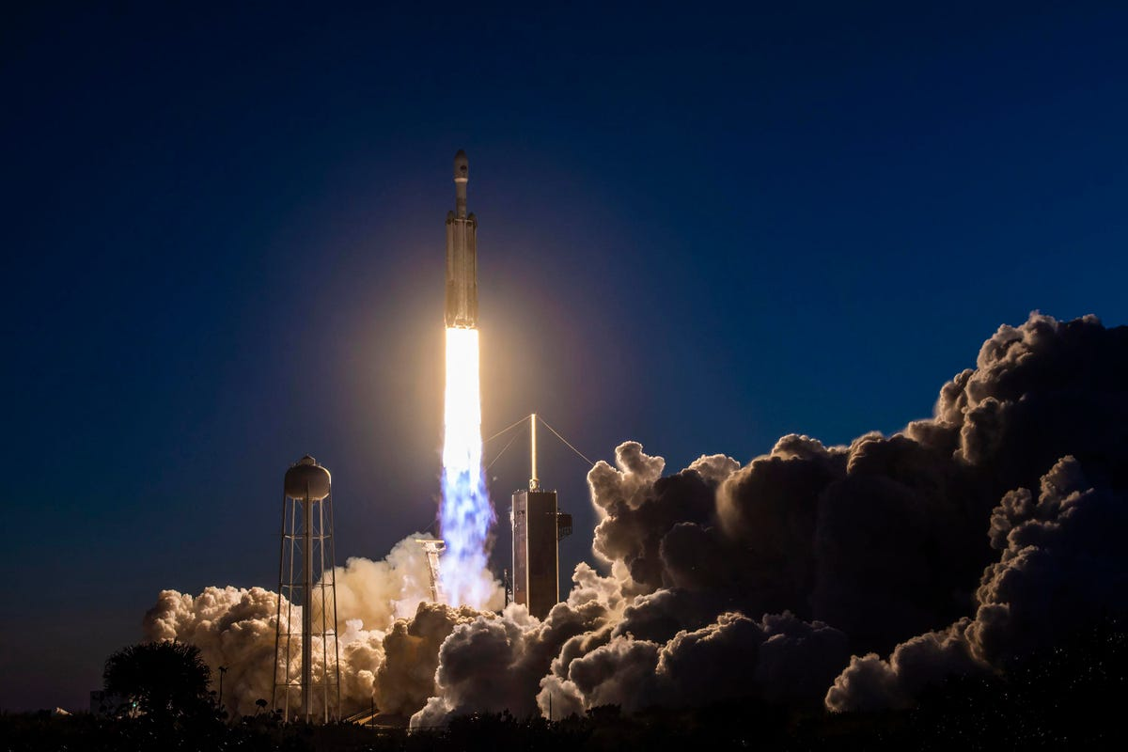
Recommendations
Use launch site location data to further improve locations for future bases
Increase the dataset as time progresses to increase model and output data to further refine results
Apply these models and practices to Falcon Heavy and Starbase as launches continue
Research or develop new tools and models, such as XGBoost, to not only reassure calculations, but also to find new data and answers, as well as keeping up with the latest in computing

Slide 46
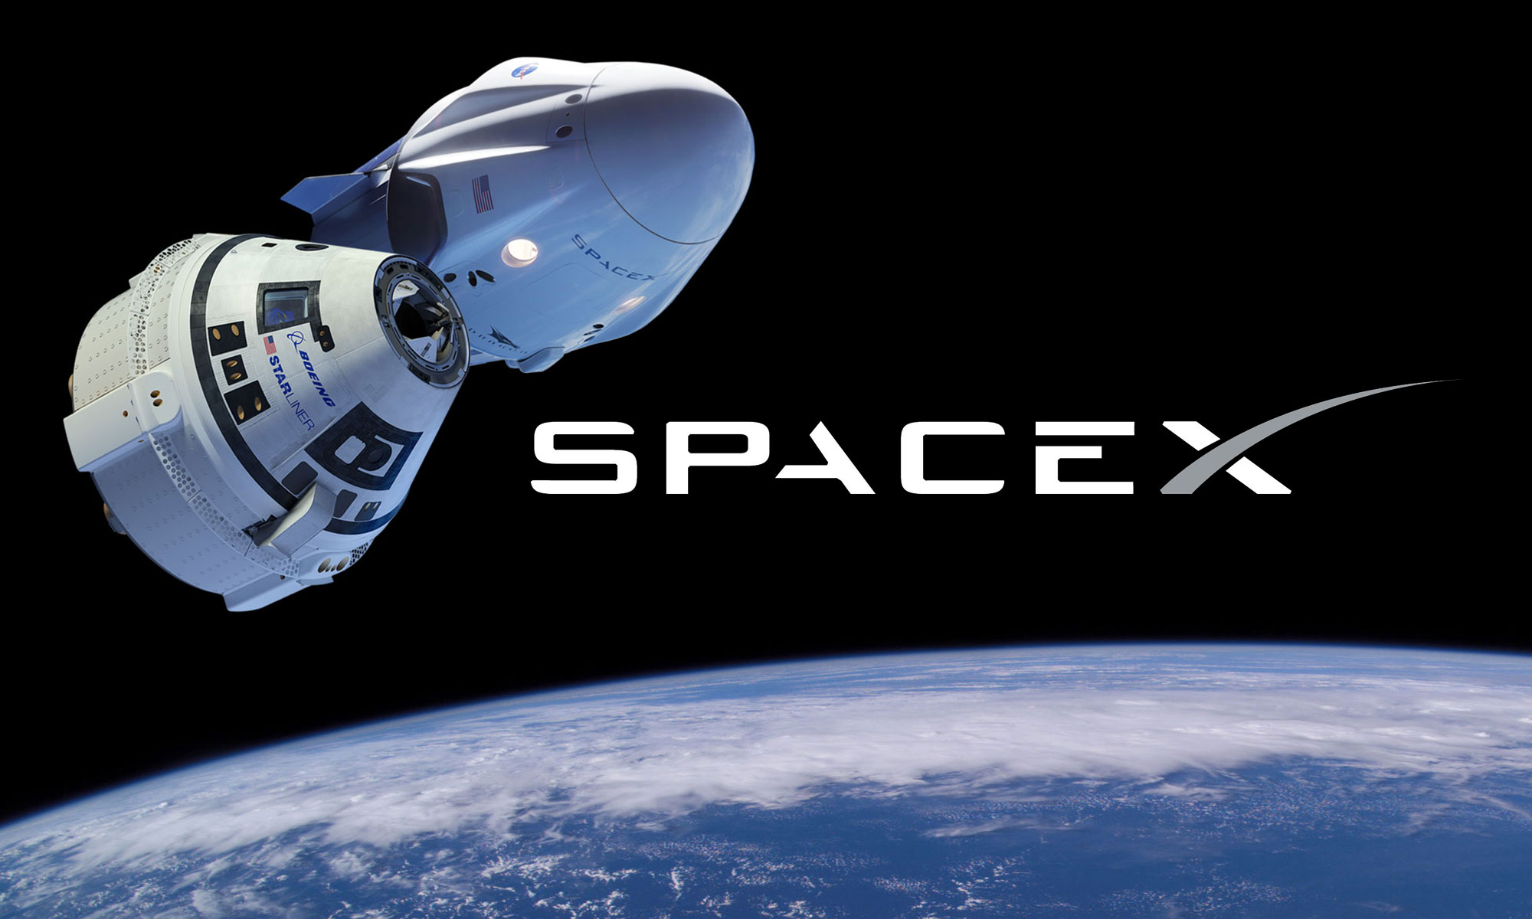
The End

